Slide 1
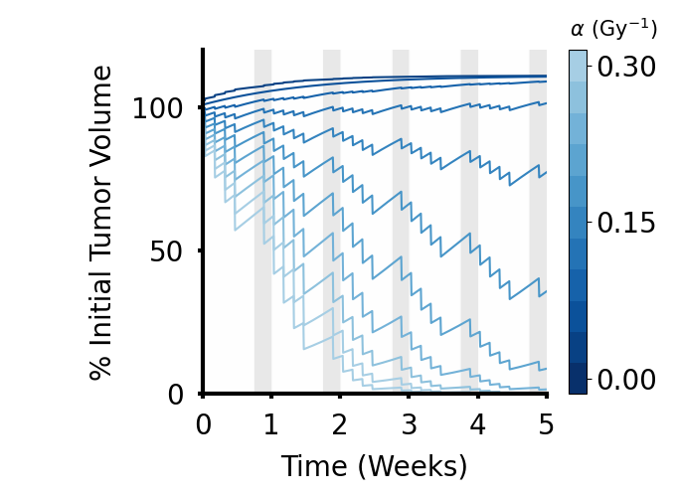
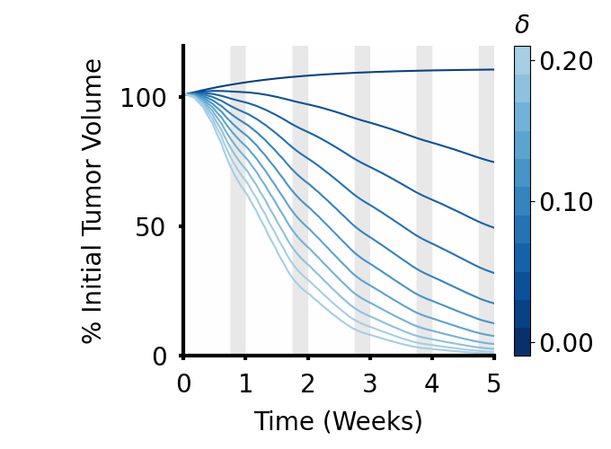
A
B

Slide 2
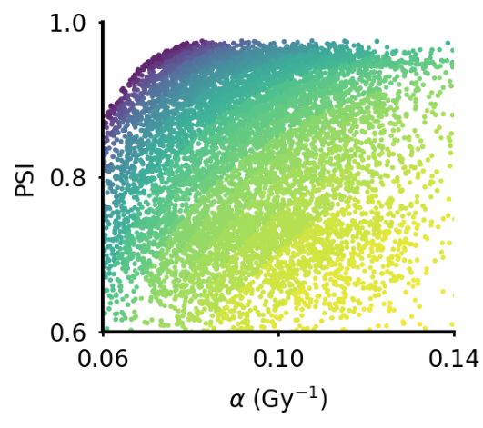
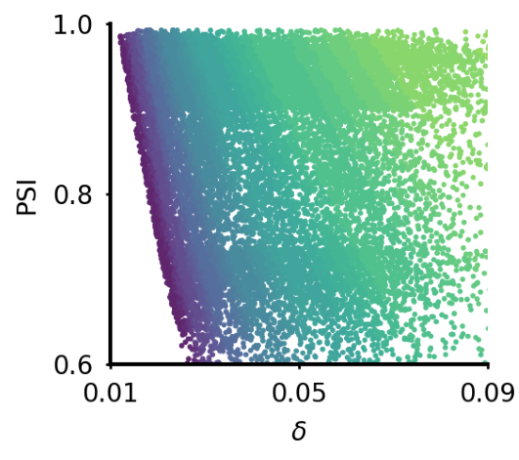
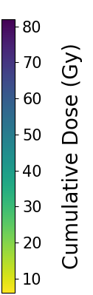
A
B

Slide 3
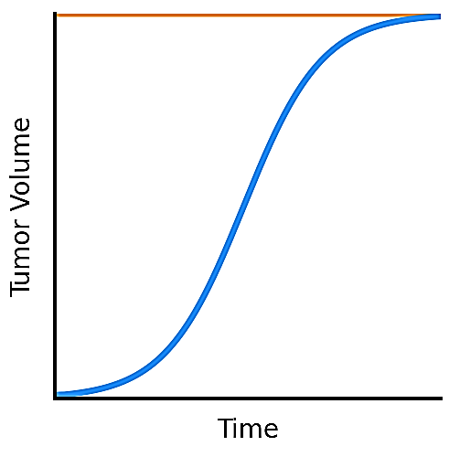
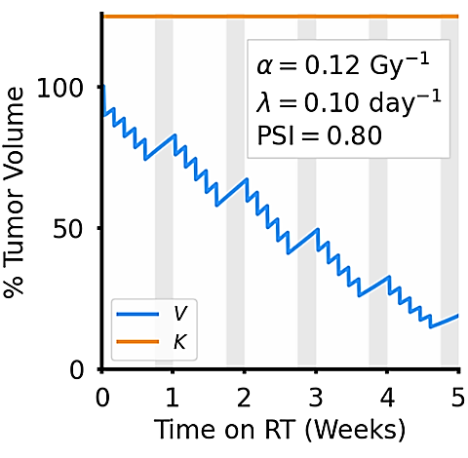
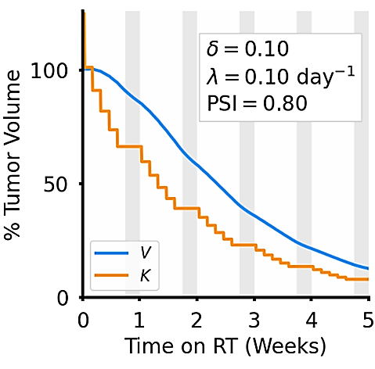
A
B
C
Figure 1. Visual depicting two phases of early tumor growth as well as projected tumor death following the administration of Radiotherapy. Panel A reflects the initial logistic model growth, where a tumor is projected to undergo rapid growth from an initial time point and reaches a carrying capacity, K, following a biological limit in resources available for further proliferation. Panel B shows the reduction in tumor volume over time for an arbitrary that undergoes Direct Cell Kill. Panel C shows the reduction in tumor volume over time for an arbitrary tumor that undergoes Indirect Cell Kill. In both Panels B and C, a Standard of Care RT regiment, shown by the arrows above each plot, is applied once every weekday for a total of five weeks of treatment, where the gray panels indicate treatment breaks (weekends). Both tumors also have the same initial growth rate λ as well as the patient-specific parameter PSI.

Slide 4
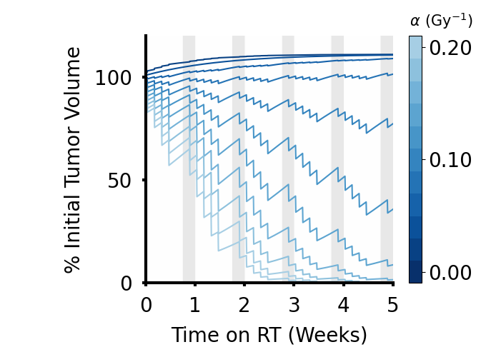
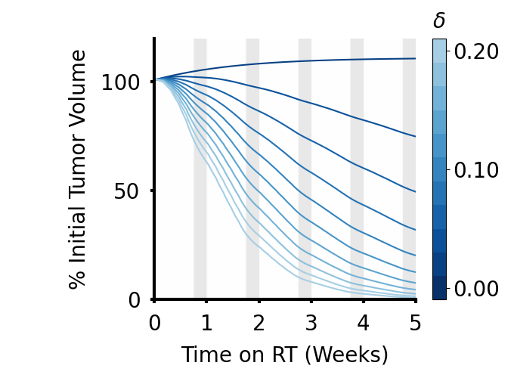

Slide 5
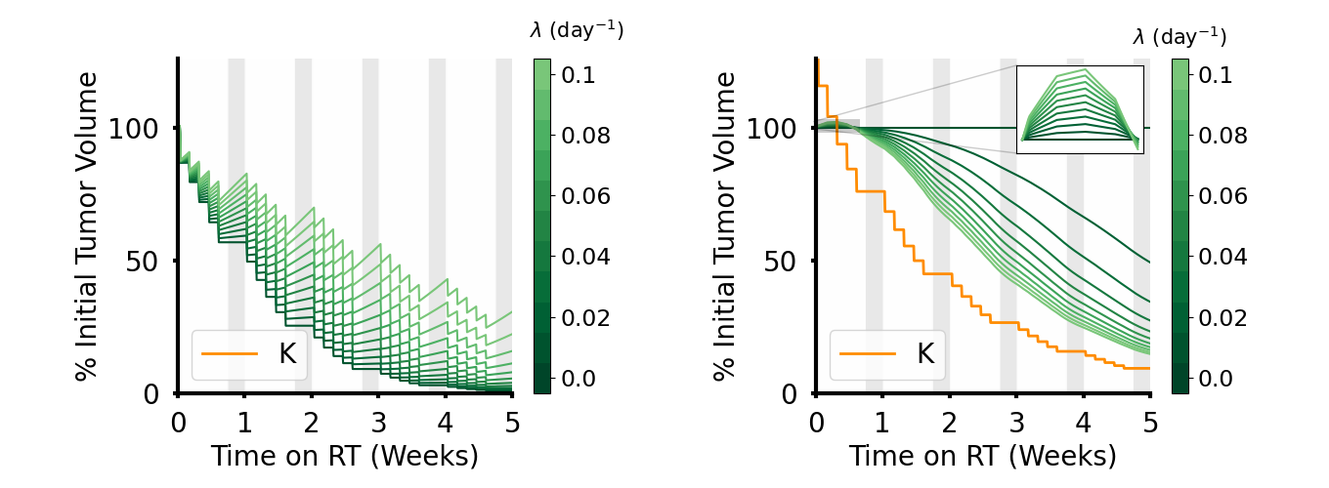

Slide 6
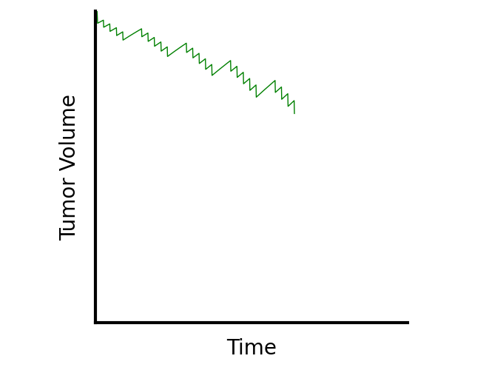
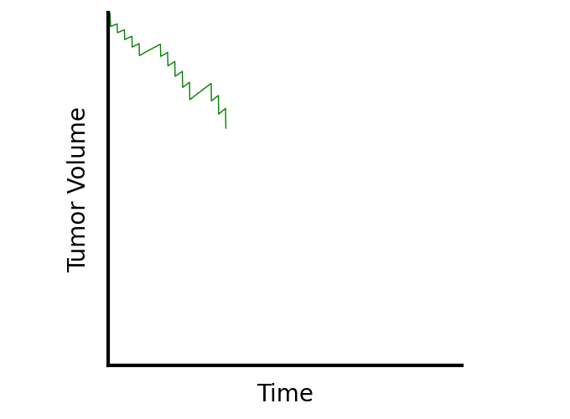
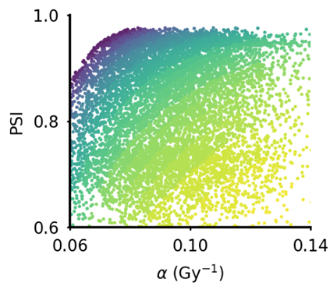
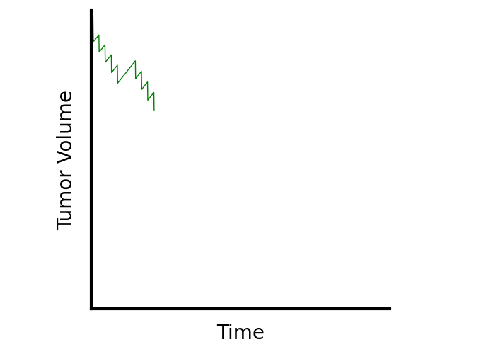
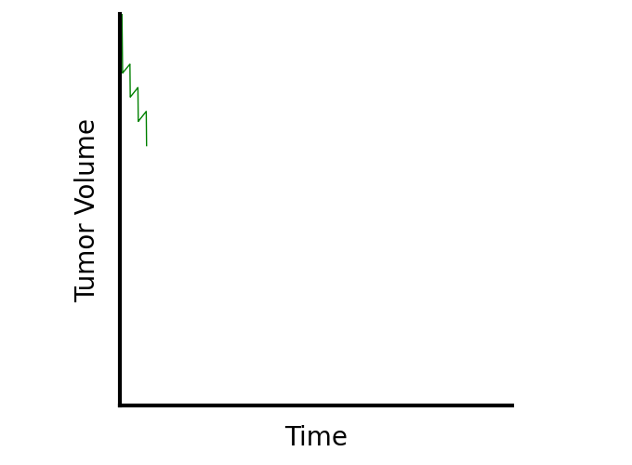
A

Slide 7
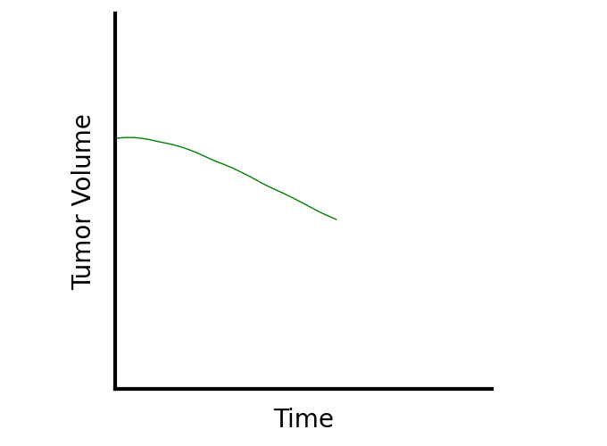
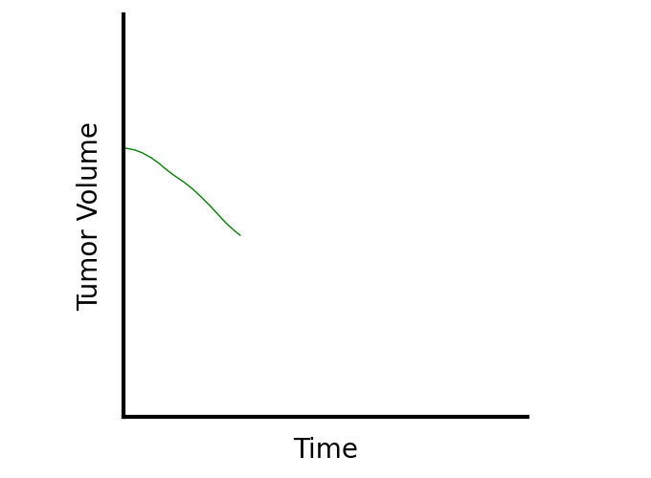
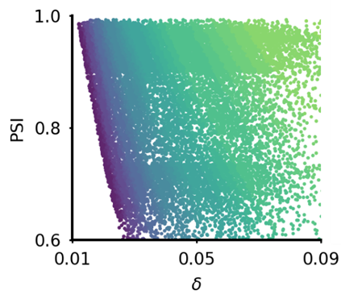
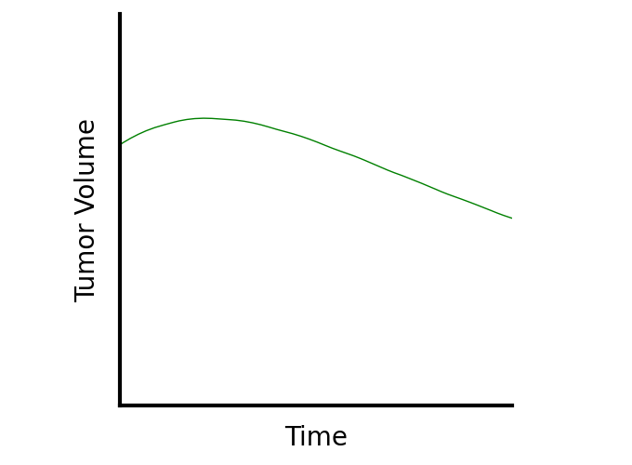
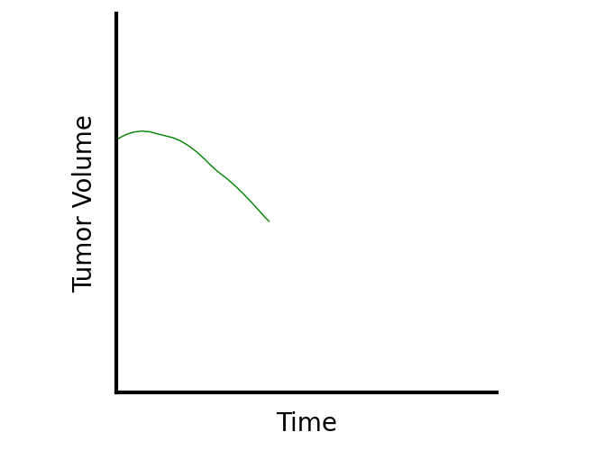
B

